Slide 1
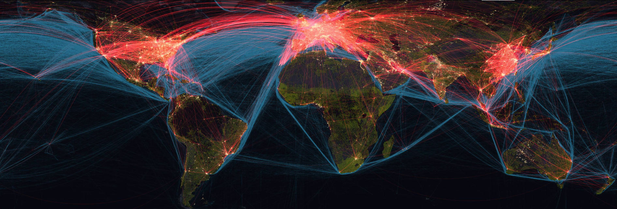
Visualizing Data Flight Data Visualizations
Project 3, Group 5
Adam Holcomb
Revathi Sundar
Ishan Chakrabarty
Simon Castellanos
Morteza Akbari

Slide 2
Agenda
Overview of Data
Dataset record (~186)
Python Flask
HTML/CSS
JavaScript
Bar Char
Bubble Chart
Flight Map

Slide 3
Dashboard Overview

Slide 4
Visualization 1 (Bar Chart)

Slide 5
Visualization 2 (Bubble Chart)

Slide 6
Visualization 3 (Flight Map)

Slide 7
Specific Requirements
Your visualization must include a Python Flask–powered API, HTML/CSS, JavaScript, and at least one database (SQL, MongoDB, SQLite, etc.).
Your project should fall into one of the below three tracks:
A combination of web scraping and Leaflet or Plotly
A dashboard page with multiple charts that update from the same data
A server that performs multiple manipulations on data in a database prior to visualization (must be approved)
Your project should include at least one JS library that we did not cover.
Your project must be powered by a dataset with at least 100 records.
Your project must include some level of user-driven interaction (e.g., menus, dropdowns, textboxes).
Your final visualization should ideally include at least three views.

